Slide 1
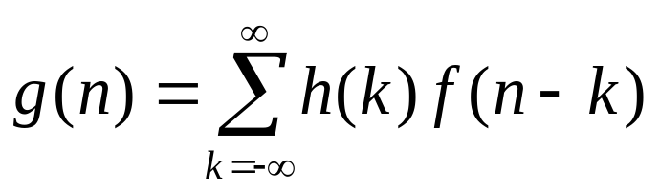
Three-Steps of Linear Convolution
For any given n, how to obtain
  Step 1: time reversal of either signal (e.g., f(k)→f(-k) )
  Step 2: shift f(-k) by n samples to obtain f(n-k)
  Step 3: multiply h(k) and f(n-k) for each k and then take the summation over k
Note
You need to change variable n to get the whole sequence.

Slide 2
1D Linear Convolution
f(n)=[1 2 3 4]
h(n)=[1 –1]
4
3
1
2
1
o
-1
o
origin

Slide 3
Step 1:Time Reversal
h(k)=[1 –1]
h(-k)=[–1 1]
1
1
o
o
-1
-1

Slide 4
Step 2: Shift
h(-k)
h(1-k)
h(2-k)
1
1
1
o
o
o
-1
-1
n=1
n=0
n=2
4
3
2
f(k)=[1 2 3 4]
1
o

Slide 5
Step3: Multiply-and-Add
g(0)=1
g(2)=1
g(1)=1
1
1
1
o
o
o
-1
-1
n=2
n=0
n=1
4
3
2
f(k)=[1 2 3 4]
1
o

Slide 6

Final Result
f(n)=[1 2 3 4]
h(n)=[1 –1]
g(n)=[1 1 1 1 -4]
If the lengths of two input signals are N₁ and N₂ respectively,
the length of the output signal will be N₁+N₂-1.

Slide 7
2D Linear Convolution
n
n
x(m,n)
h(m,n)
4 1
2 5 3
1
1 -1
m
m

Slide 8
Step 1:Time Reversal
h(m,n)
h(m,-n)
h(-m,-n)
n
1
1 -1
m
-1
1 1
-1 1
1 1

Slide 9
Step 2: Shift
l
h(1-k,1-l)
h(1-k,-l)
-1 1
1 1
h(-k,-l)
4 1
2 5 3
-1 1
1 1
-1 1
1 1
k
x(k,l)

Slide 10
Step3: Multiply-and-Add
l
y(1,1)=10
y(1,0)=3
-1 1
1 1
y(0,0)=2
4 1
2 5 3
-1 1
1 1
-1 1
1 1
k
x(k,l)

